Slide 1
CSC479
Data Mining
Classification Lecture 3
Basic Concepts
Decision Trees
(Ch # 8: Data Mining-Concepts and Techniques by Han and Kamber)

Slide 2
Information Gain
Gain of an attribute split: compare the impurity of the parent node with the average impurity of the child nodes
Maximizing the gain ⇔ Minimizing the weighted average impurity measure of children nodes
ID3 uses information gain

Slide 3
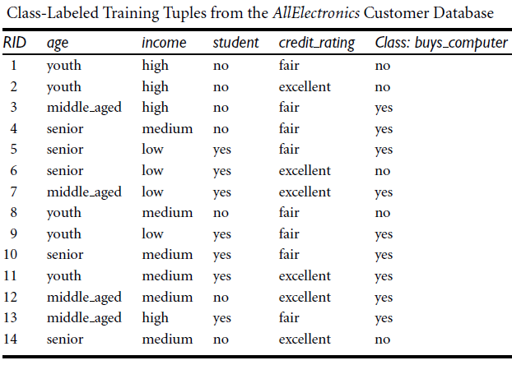





Examples Constructing Decision Tree

Slide 4
Examples Constructing Decision Tree
So the attribute Age will be placed at root level.
For placement at second level we find InfoGain for all the remaining attributes under every branch of the parent node.

Slide 5
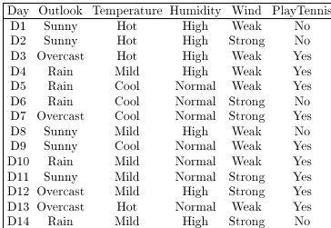
DECISION TREES
Which Attribute is the Best Classifier?: Information Gain

Slide 6
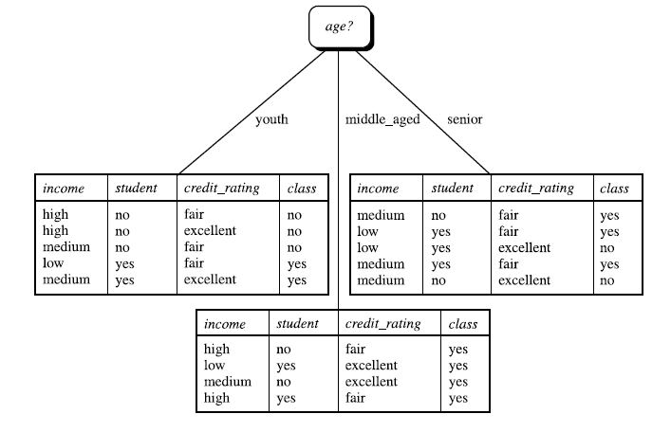

Slide 7
DECISION TREES
Which Attribute is the Best Classifier?: Information Gain
The collection of examples has 9 positive values and 5 negative ones
Eight (6 positive and 2 negative ones) of these examples have the attribute value Wind = Weak
Six (3 positive and 3 negative ones) of these examples have the attribute value Wind = Strong

Slide 8
DECISION TREES
Which Attribute is the Best Classifier?: Information Gain
The information gain obtained by separating the examples according to the attribute Wind is calculated as:

Slide 9
DECISION TREES
Which Attribute is the Best Classifier?: Information Gain
We calculate the Info Gain for each attribute and select the attribute having the highest Info Gain

Slide 10
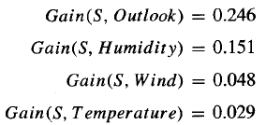
DECISION TREES
Example
Which attribute should be selected as the first test?
“Outlook” provides the most information

Slide 11
DECISION TREES

Slide 12
DECISION TREES
Example
The process of selecting a new attribute is now repeated for each (non-terminal) descendant node, this time using only training examples associated with that node
Attributes that have been incorporated higher in the tree are excluded, so that any given attribute can appear at most once along any path through the tree

Slide 13
DECISION TREES
Example
This process continues for each new leaf node until either:
Every attribute has already been included along this path through the tree
The training examples associated with a leaf node have zero entropy

Slide 14
DECISION TREES
Example

Slide 15
DECISION TREES
From Decision Trees to Rules
Next Step: Make rules from the decision tree
After making the identification tree, we trace each path from the root node to leaf node, recording the test outcomes as antecedents and the leaf node classification as the consequent
Simple way: one rule for each leaf
For our example we have:
If the Outlook is Sunny and the Humidity is High then No
If the Outlook is Sunny and the Humidity is Normal then Yes
...

Slide 16

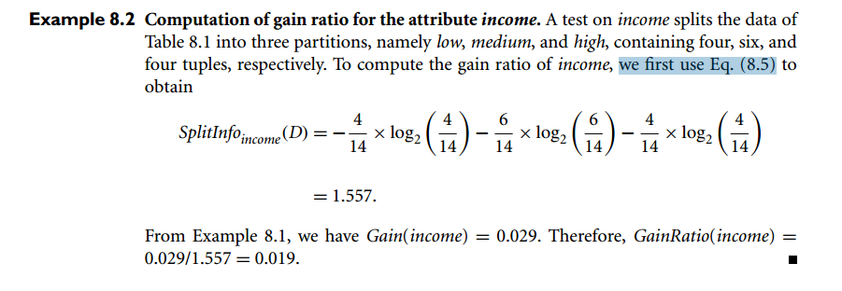
Gain Ratio

Slide 17
Gini Index (CART, IBM IntelligentMiner)
If a data set D contains examples from n classes, gini index, gini(D) is defined as
where p_{j} is the relative frequency of class j in D
If a data set D is split on A into two subsets D₁ and D₂, the gini index gini(D) is defined as
Reduction in Impurity:
The attribute provides the smallest gini_{split}(D) (or the largest reduction in impurity) is chosen to split the node (need to enumerate all the possible splitting points for each attribute)

Slide 18
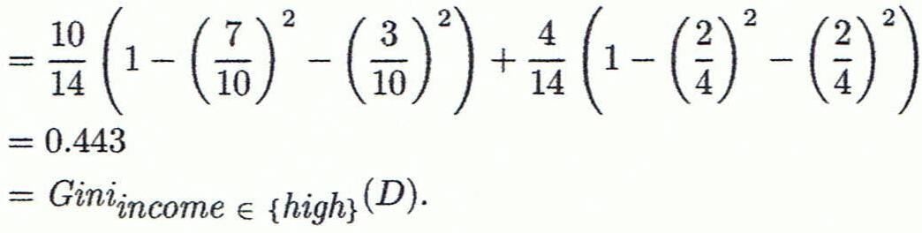
Computation of Gini Index
Ex. D has 9 tuples in buys_computer = “yes” and 5 in “no”
Suppose the attribute income partitions D into 10 in D₁: {low, medium} and 4 in D₂
Gini_{{low,high}} is 0.458; Gini_{{medium,high}} is 0.450. Thus, split on the {low,medium} (and {high}) since it has the lowest Gini index
All attributes are assumed continuous-valued
May need other tools, e.g., clustering, to get the possible split values

Slide 19

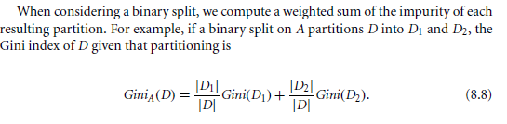


Slide 20
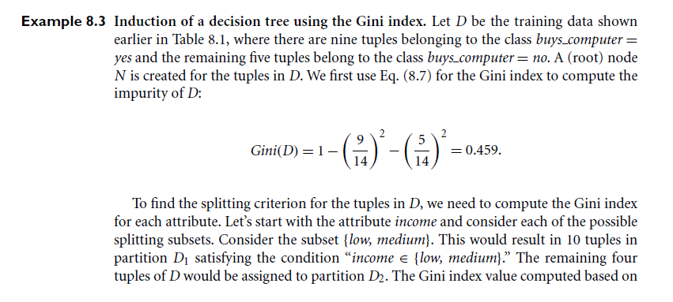

Slide 21
